Slide 1
Predictive Modelling For Cab Rides A predictive model based on weather parameters
Karan Barai
Ravi Munde

Slide 2
Introduction
Boston has on of the highest cab ride frequency in the country^{[1]}
Cab prices vary depending on various conditions like weather and time
Our aim is build a streaming framework to analyse this price fluctuation and predict the price given the set of features in real time
Comparing the magnitude of fluctuation between Uber and Lyft

Slide 3
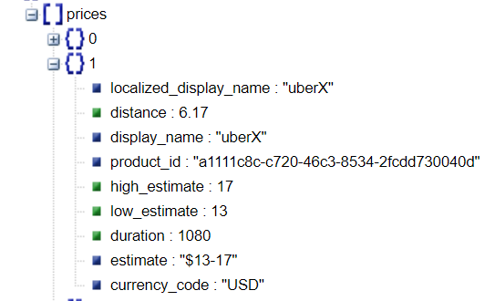
Uber & Lyft data
Uber Developer API
Provides a price estimate for the ride between two points in real time
Inputs required: Start and End point co-ordinates(latitude & longitude)
Current price estimate in response
Sample Uber ride schema

Slide 4
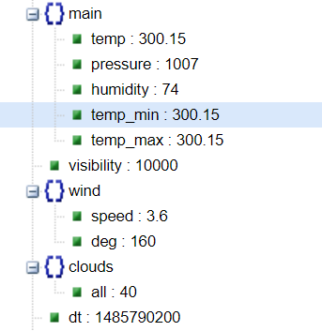
Weather Data
OpenWeatherMap API
Current weather report for a given location
Additional weather conditions available when relevant(snow, rain, etc)
Sample weather schema

Slide 5
Stack
Scala
DynamoDB
Uber API, Lyft API, OpenWeatherMap API
Spark(MLlib & Streaming) on Databricks
Git
AWS

Slide 6



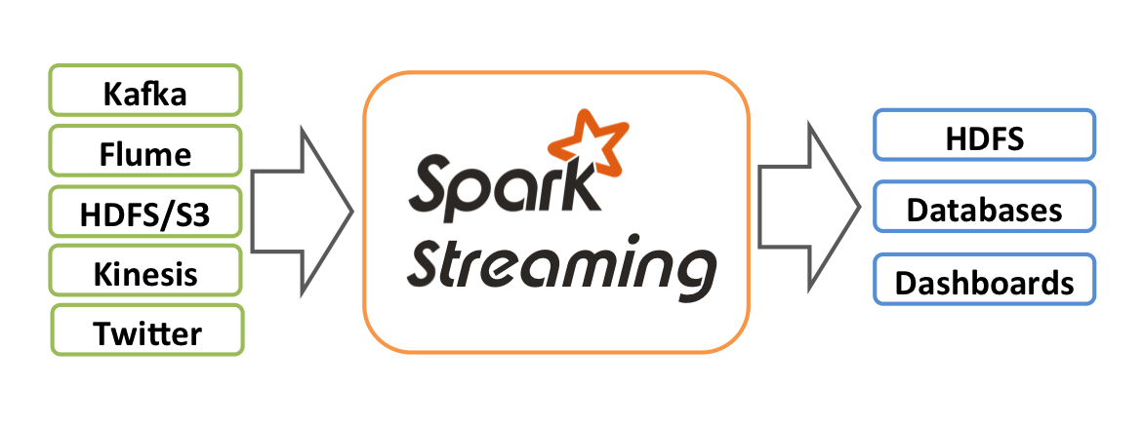


Use Case
Data Collection through individual API and store in DyanamoDb
Data Analysis and prediction on Spark using Streaming and MLlib
Spark Cluster/Databricks
Prediction

Slide 7
About Data
Collected data to DynamoDB NoSQL database using individual APIs
Frequency of data collection for 7 days:
Uber : Every 2 mins (4 records)
Lyft : Every 2 mins(6 records)
Weather: Every 1 hr (1 record)
Estimated record count is 100k(Can be 50k-60k if API limits are hit)
Join data sources using Spark Streaming for analysis and building models

Slide 8
Time lines
11/23 (Sprint 1)
Actors to query Uber, Lyft & Weather APIs(Ravi & Karan)
Set up jobs on AWS EC2(Ravi)
Data Collection and storage on DyanmoDB(Karan)
11/30 (Sprint 2)
Setup Spark Streaming(Karan)
Exploratory data analysis(Ravi)
Feature Engineering(both)
12/07 (Sprint 3)
Predictive Modelling using MLlib(both)
Model Evaluation(both)

Slide 9
Evaluation Criteria
Accuracy of 75% on the predicted prices

Slide 10
Thank You

